Slide 1
Java I/O - II
Lecture 23

Slide 2
Learning objectives:
After the completion of today’s session you will be able to:
Create files using file class in java.
Demonstrate the use of various stream based and character based file handling mechanism in java.

Slide 3
Java File Class
The File class is an abstract representation of file and directory pathname.
A pathname can be either absolute or relative.
The File class have several methods for working with directories and files such as creating new directories or files, deleting and renaming directories or files, listing the contents of a directory etc.

Slide 4
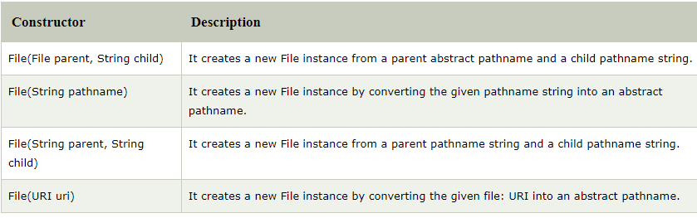
Java File Class Constructor
Note: An abstract pathname is a java.io.File object and a pathname string is a java.lang.string object, Both refers to same file on disk

Slide 5
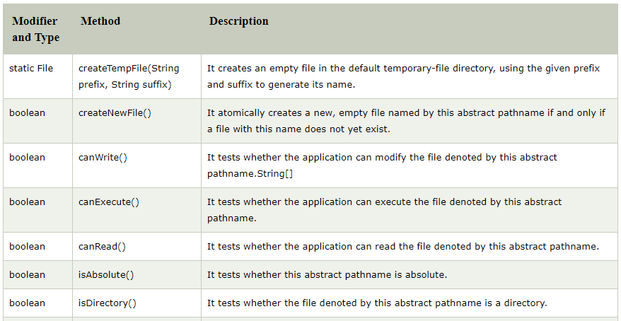
Java File Class Methods

Slide 6
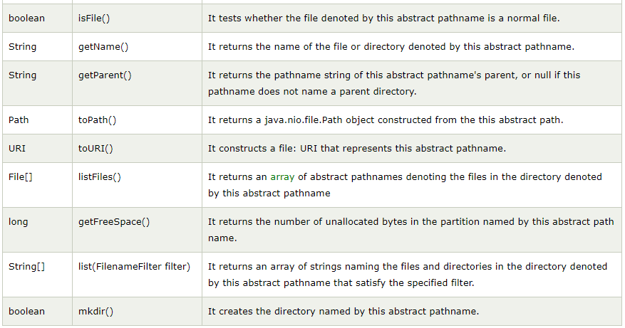
Java File Class Methods

Slide 7
Java FileInputStream class
Java FileInputStream class obtains input bytes from a file.
It is used for reading byte-oriented data (streams of raw bytes) such as image data, audio, video etc.
You can also read character-stream data.
But, for reading streams of characters, it is recommended to use FileReader class.
The java.io.InputStream.read() method reads the next byte of the data from the input stream and returns int in the range of 0 to 255.
If no byte is available because the end of the stream has been reached, the returned value is -1.
First create a file and then read it.

Slide 8
Java FileOutputStream class
Java FileOutputStream is an output stream used for writing data to a file.
If you have to write primitive values into a file, use FileOutputStream class.
You can write byte-oriented as well as character-oriented data through FileOutputStream class.
But, for character-oriented data, it is preferred to use FileWriter than FileOutputStream.
The java.io.OutputStream.write(byte[] b) method writes b.length bytes from the specified byte array to this output stream.
File will be automatically created.

Slide 9
Java FileReader class
Java FileReader class is used to read data from the file.
It returns data in byte format like FileInputStream class.
It is character-oriented class which is used for file handling in java.
First create a file and then read it.

Slide 10
Java FileWriter class
Java FileWriter class is used to write character-oriented data to a file.
It is character-oriented class which is used for file handling in java.
Unlike FileOutputStream class, you don't need to convert string into byte array because it provides method to write string directly.
File will be automatically created.

Slide 11
Java BufferedReader class
Java BufferedReader class is used to read the text from a character-based input stream.
It can be used to read data line by line by readLine() method.
It makes the performance fast.
It inherits Reader class.
First create a file and then read it if reading from a file.

Slide 12
Java BufferedWriter class
Java BufferedWriter class is used to provide buffering for Writer instances.
It makes the performance fast.
It inherits Writer class.
The buffering characters are used for providing the efficient writing of single arrays, characters, and strings.
File will be automatically created.

Slide 13
Thanks

